Slide 1

Cybersecurity Awareness Training
2022

Slide 2
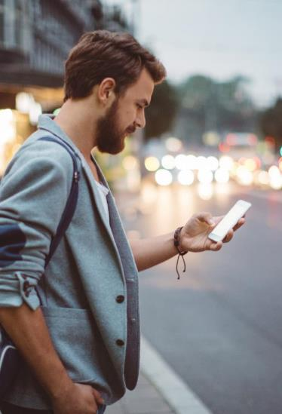
Agenda
Welcome and introduction
Social engineering scams and attacks
Break
Social engineering prevention strategies
Lunch
Social media compromise and safety
Break
Stay cyber-safe when working remotely.
Closing remarks

Slide 3

The Internet,
Deep Web, and Dark Web
Internet
What does it all mean?
Deep Web
Indexed vs. non-indexed
Good vs. bad
Dark Web

Slide 4
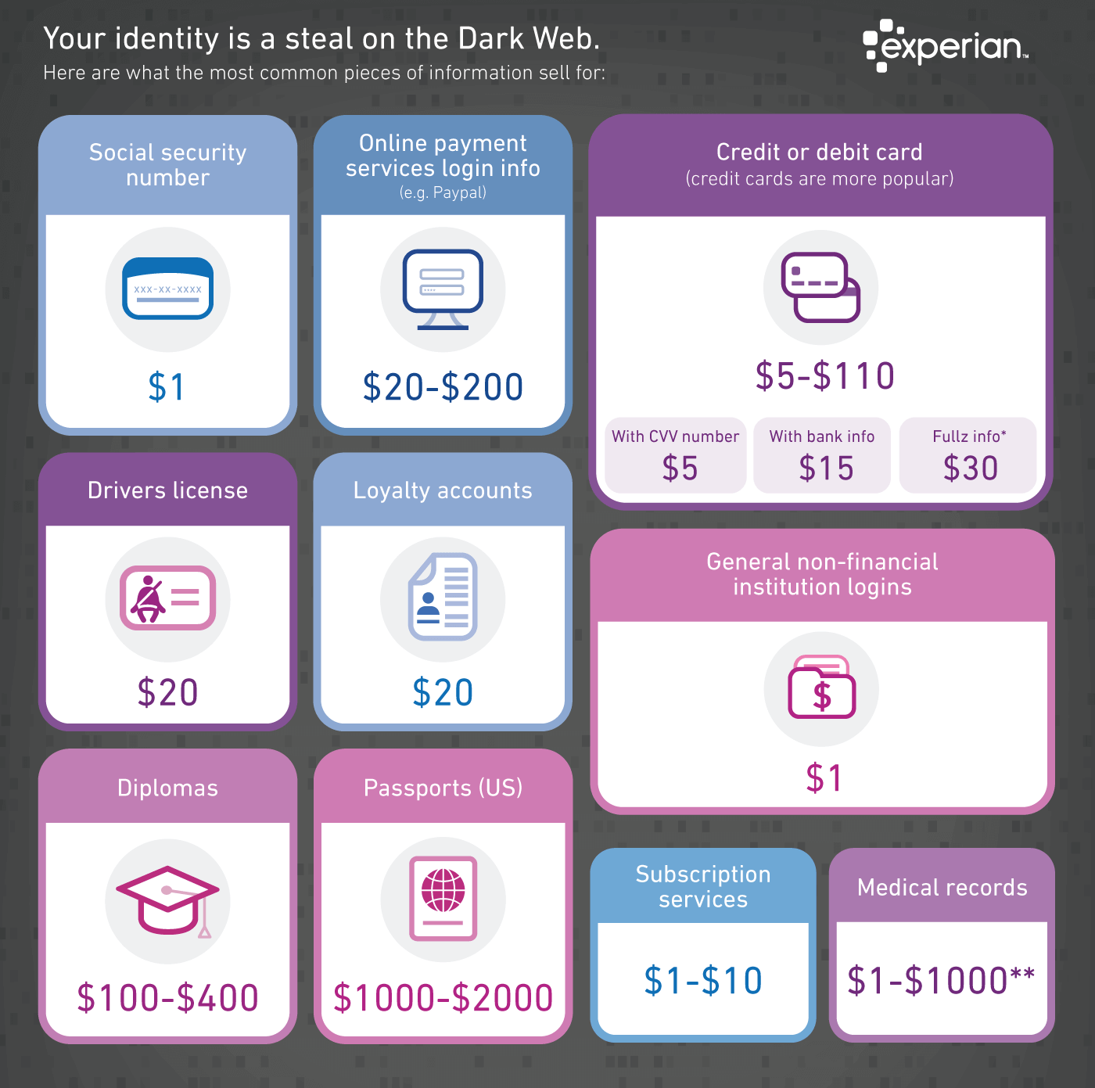
How much is your data worth?
https://www.experian.com/blogs/ask-experian/heres-how-much-your-personal-information-is-selling-for-on-the-dark-web/

Slide 5

Amazing Social Media Statistics
The smartphone is the device of choice for most US mobile social network users; more than 150 million in United States alone.
An estimated 30 thousand websites a day are hacked.
Approximately 313 million users monthly on Twitter.
Approximately 433 million users on LinkedIn.
Approximately 500 million monthly users on Instagram.
Approximately 176 registered users on Pinterest.
Approximately 256 days to spot a social medial breach.
Approximately 88 days to contain a breach.
Source (2017): https://www.cdse.edu/Training/Security-Training-Videos/Cybersecurity/Social-Media/

Slide 6
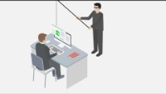
What is phishing?
Source: https://youtu.be/Y7zNlEMDmI4

Slide 7
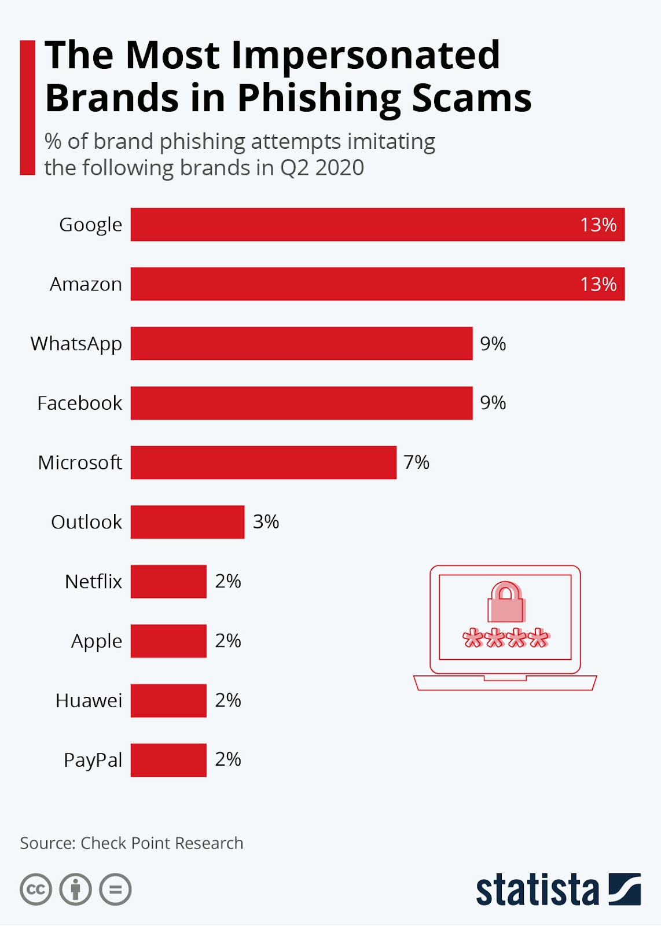
The most impersonated brands in phishing scams
Do you use any of these brands?

Slide 8
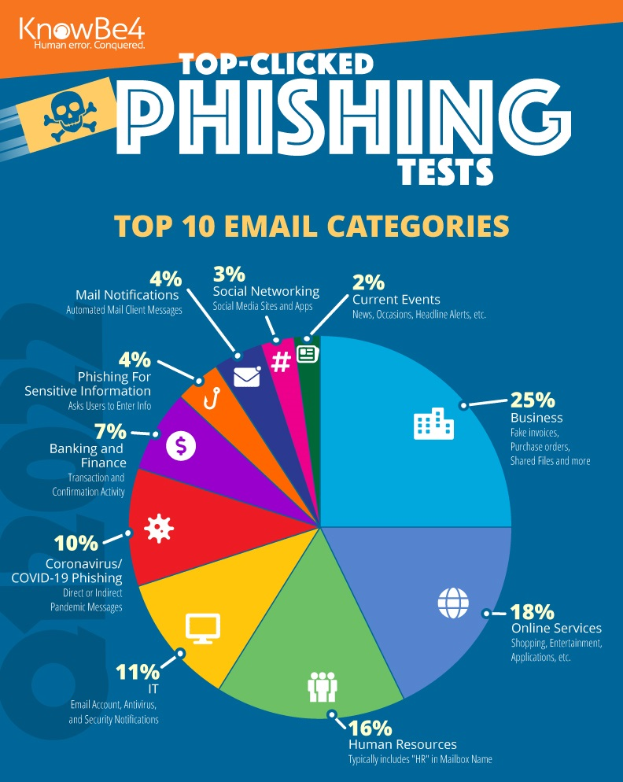
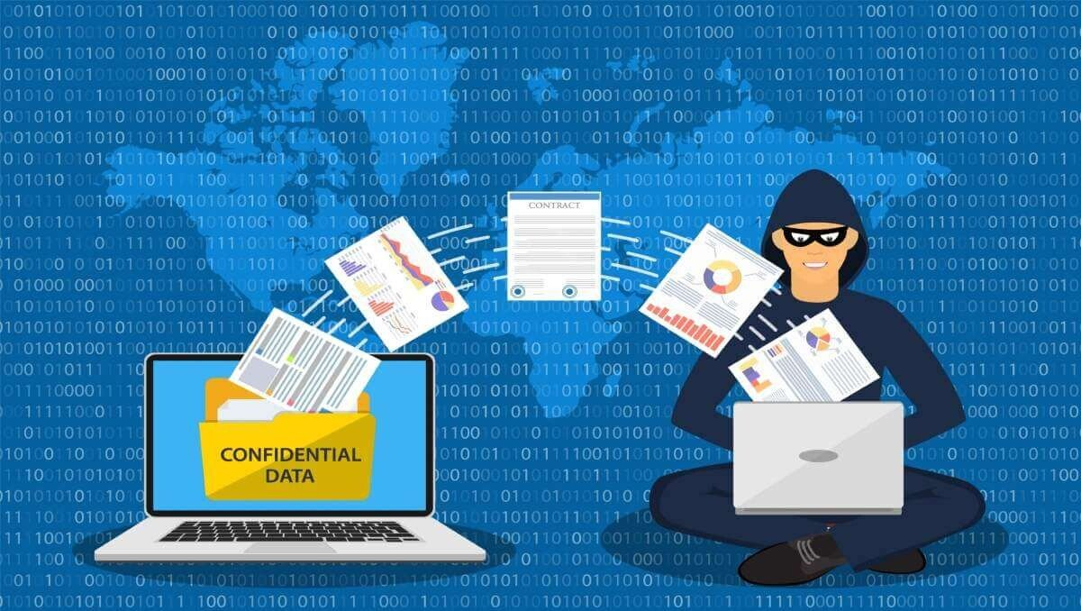
Business is the top most phished e-mail category
for Q1 2022.
Source: https://blog.knowbe4.com/q2-2022-phishing-results-holiday-emails-entice-employees
This Photo by Unknown Author is licensed under CC BY-NC-ND

Slide 9
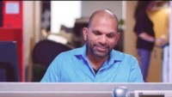
What is vishing?
Source: https://youtu.be/Hc01oZPvByg

Slide 10
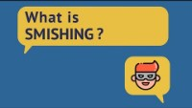
What is smishing?
Source: https://youtu.be/ZOZGQeG8avQ

Slide 11
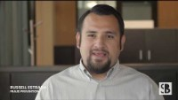
Business Email Compromise
Source: https://youtu.be/h3ipCcndlq0

Slide 12

Quid Pro Quo Scams
Scammers pretend to be from an IT department or other technical service provider.
Offers incentives (e.g., speed up your internet or fix a computer problem).
Asks you to create a free account or provide/verify your login credentials.
Scammer takes this information and uses it against you, sells it on the dark web, or installs malware for an even larger hack.

Slide 13

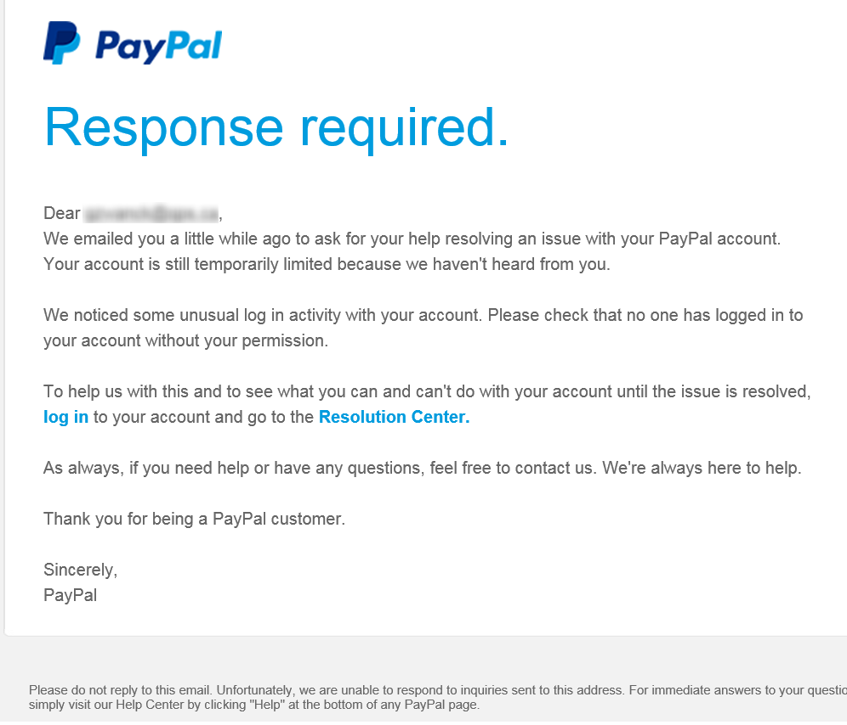
Scareware
Source: https://www.phishing.org/phishing-examples?hsLang=en

Slide 14
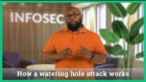

Watering Hole Attack
Source: https://youtu.be/nNzUg_gW1tI
This Photo by Unknown Author is licensed under CC BY-NC

Slide 15




Did you click on that link at…
At home
    Report it immediately to the IT Security hotline or click on the “Phish Report” button on your email task bar.
work?
home?
    Change your passwords for as many accounts as you have.
    File a report with the Federal Trade Commission (FTC) at https://reportfraud.ftc.gov/#/.

Slide 16
BREAK

Slide 17


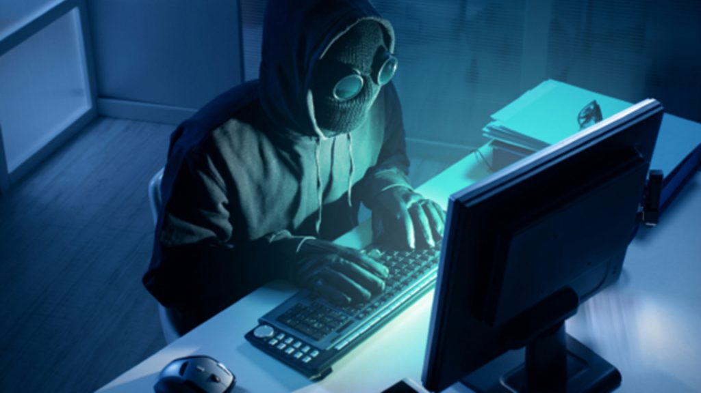
The Do’s and Do Not’s of Cybersecurity Awareness
Carefully check email names, addresses, and copy for spelling and grammar mistakes.
Stay informed about the latest phishing techniques being used.
Always verify the sender of suspicious emails.
Report ransomware to the FBI.
Report suspicious emails to your IT department.
Think before you click.
Install an anti-phishing toolbar.
Verify a website’s security by checking for a padlock icon.
Regularly check your financial accounts.
Keep your browser and computer patches up to date.
Use an antivirus software.
Reduce your social media footprint.
Use a Virtual Private Network (VPN) connection on your laptop and/or phone.
Implement multifactor authentication whenever possible.
Register with an identity theft monitoring service.
Don’t open emails from people you don’t know.
Don’t ever respond to ransomware.
Don’t delete suspicious emails.
Don’t give out your personal information.
This Photo by Unknown Author is licensed under CC BY-SA-NC

Slide 18
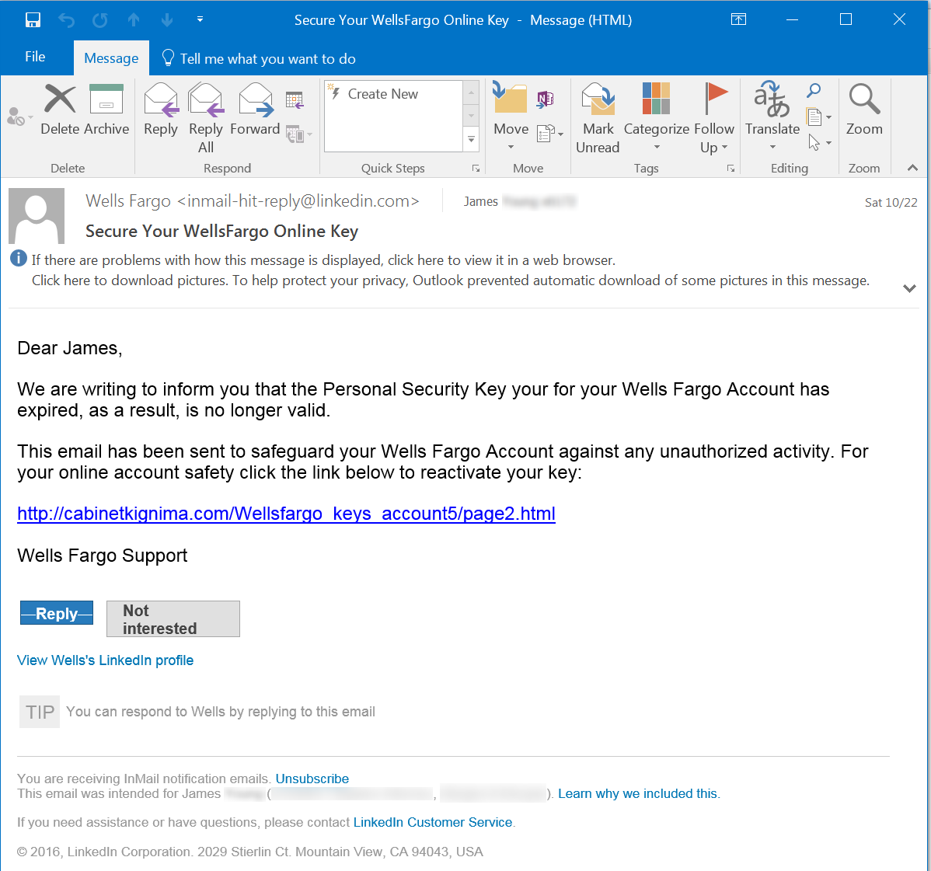
Examples of suspicious email subject lines
Notice: Your online account was accessed
IRS Tax Transcript
Celebrate Mom this Sunday with an exquisite bouquet for only $19.95
Service cancellation [date]
SHIPPING DOCUMENT / TRACKING CONFIRMATION
Confirmation for your delivery
FBI letter of notification [code 210]
Incoming fax
Notice of payment
Treat as urgent and get back to me
Your installation
Your phone number
Secure your online key
Source: https://www.phishing.org/phishing-examples?hsLang=en

Slide 19

Mind your password!
Source: https://youtu.be/0Wd3JoUHXno

Slide 20

Trick to making a strong (but memorable) password
Use a favorite quote:
You miss 100% of the shots you never take. – Wayne Gretzky
Password becomes: Ym100%otsyntWG
Use a simple sentence:
The first house I ever lived in was on 27th Street in Milwaukee, Wisconsin.
Password becomes: TfhIeliwo27SiMW

Slide 21
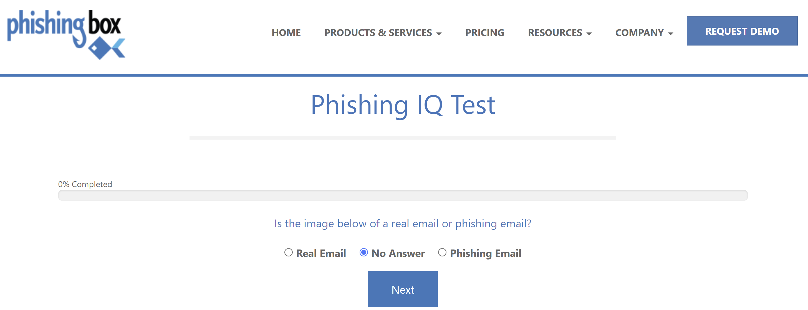
Learning Checkpoint
Open a browser and go to: https://www.phishingbox.com/phishing-iq-test

Slide 22
Lunch

Slide 23


Facebook Safety
10 Things You Should Never Share on Facebook
Facebook Thumb – Source: https://www.pikpng.com/pngl/m/5-58587_facebook-thumbs-up-icon-png-thumbs-up-facebook.png
Facebook Video – Source: https://www.youtube.com/watch?v=v_MejDubxtQ

Slide 24

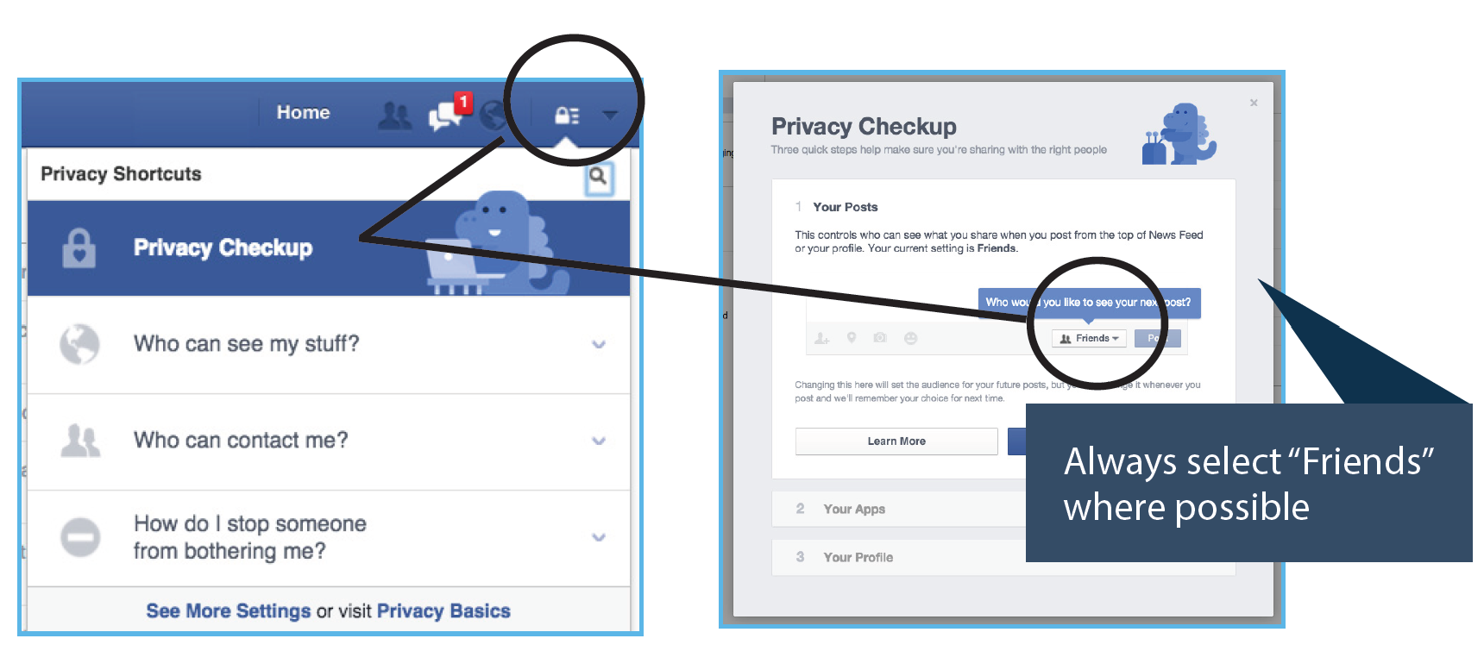
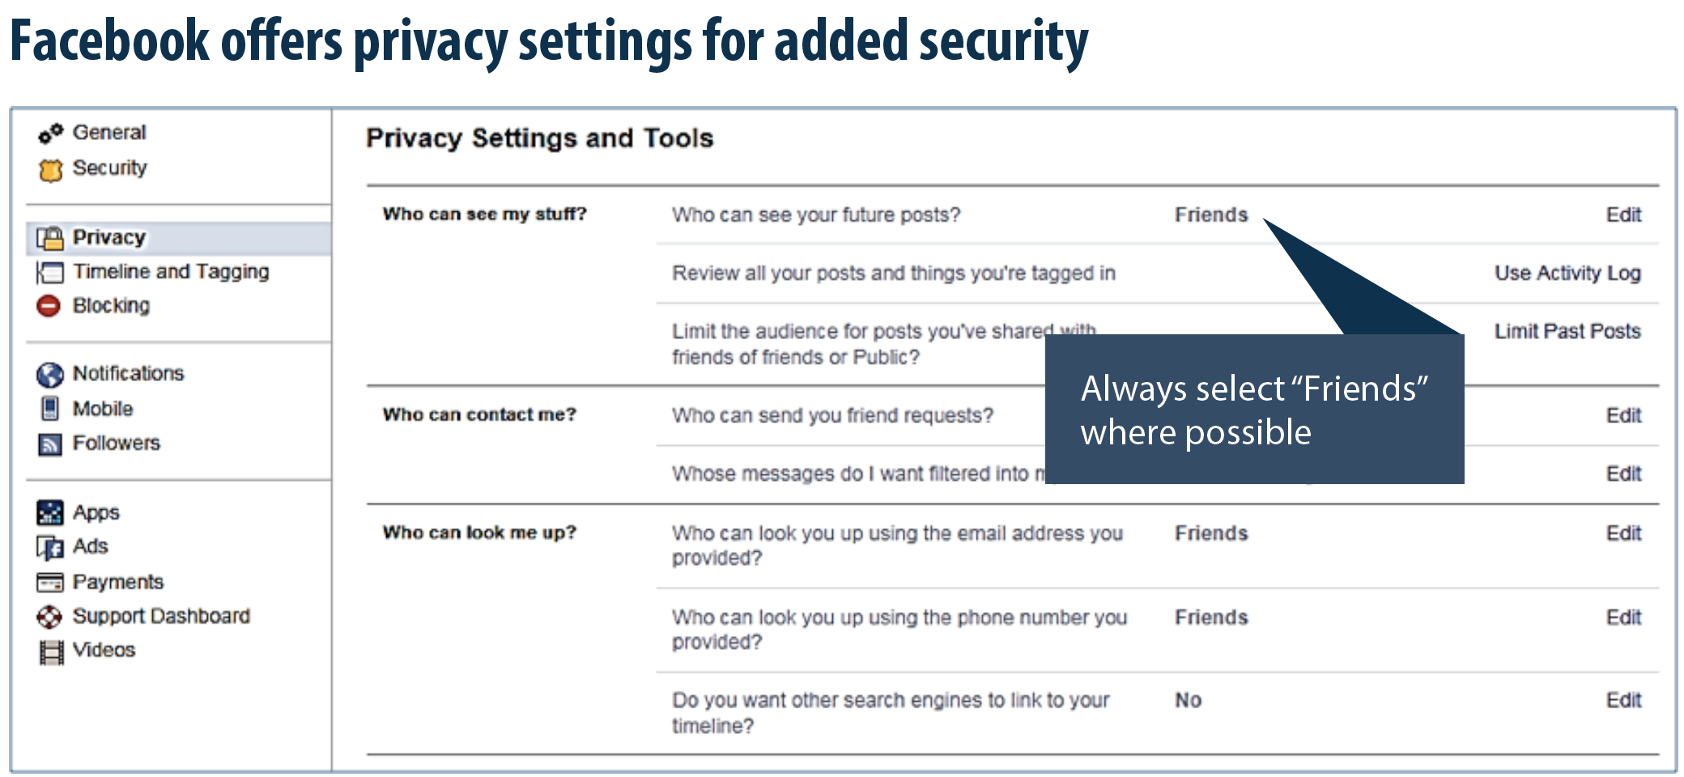
Source: https://www.cdse.edu/Portals/124/Documents/jobaids/cyber/cyb-facebook-smartcard.pdf?ver=9evqdckfQgOngmwL7OHMOA%3d%3d

Slide 25
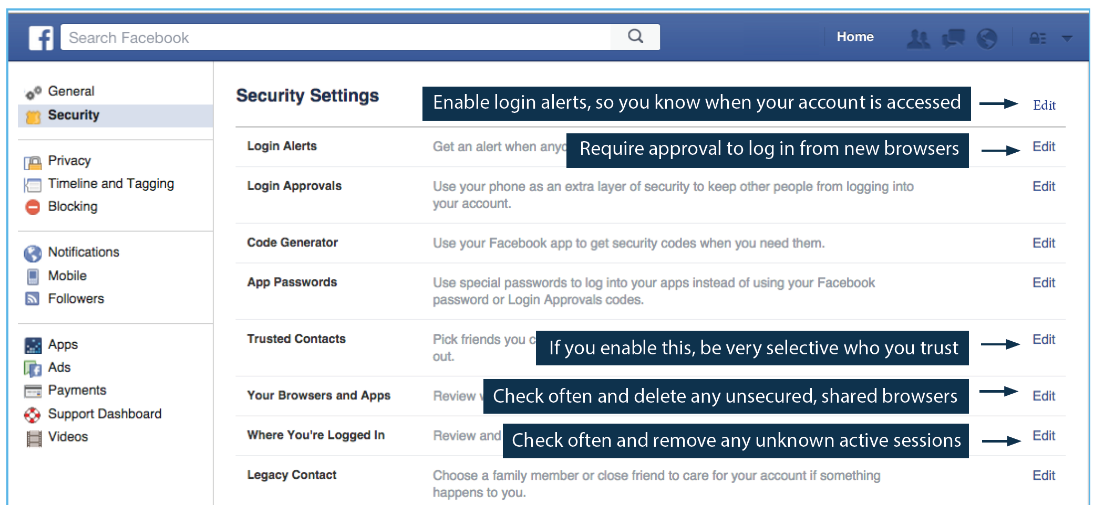
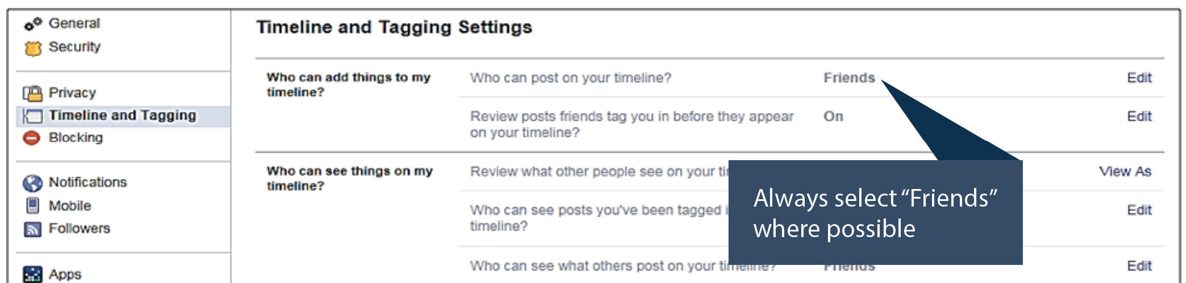
Source: https://www.cdse.edu/Portals/124/Documents/jobaids/cyber/cyb-facebook-smartcard.pdf?ver=9evqdckfQgOngmwL7OHMOA%3d%3d
To deactivate your Facebook account:
Account Settings → Security → Deactivate your account.
To reactivate your Facebook account:
Log in to Facebook with your email address and password.
To delete your Facebook account:
Help → type “Delete” into the search box → select “How do I permanently delete my account?” → scroll down to “submit your request here” → verify that you want to delete your account → “Submit”.

Slide 26

LinkedIn Safety
Source: https://www.youtube.com/watch?v=GW_DLLjvrsc

Slide 27
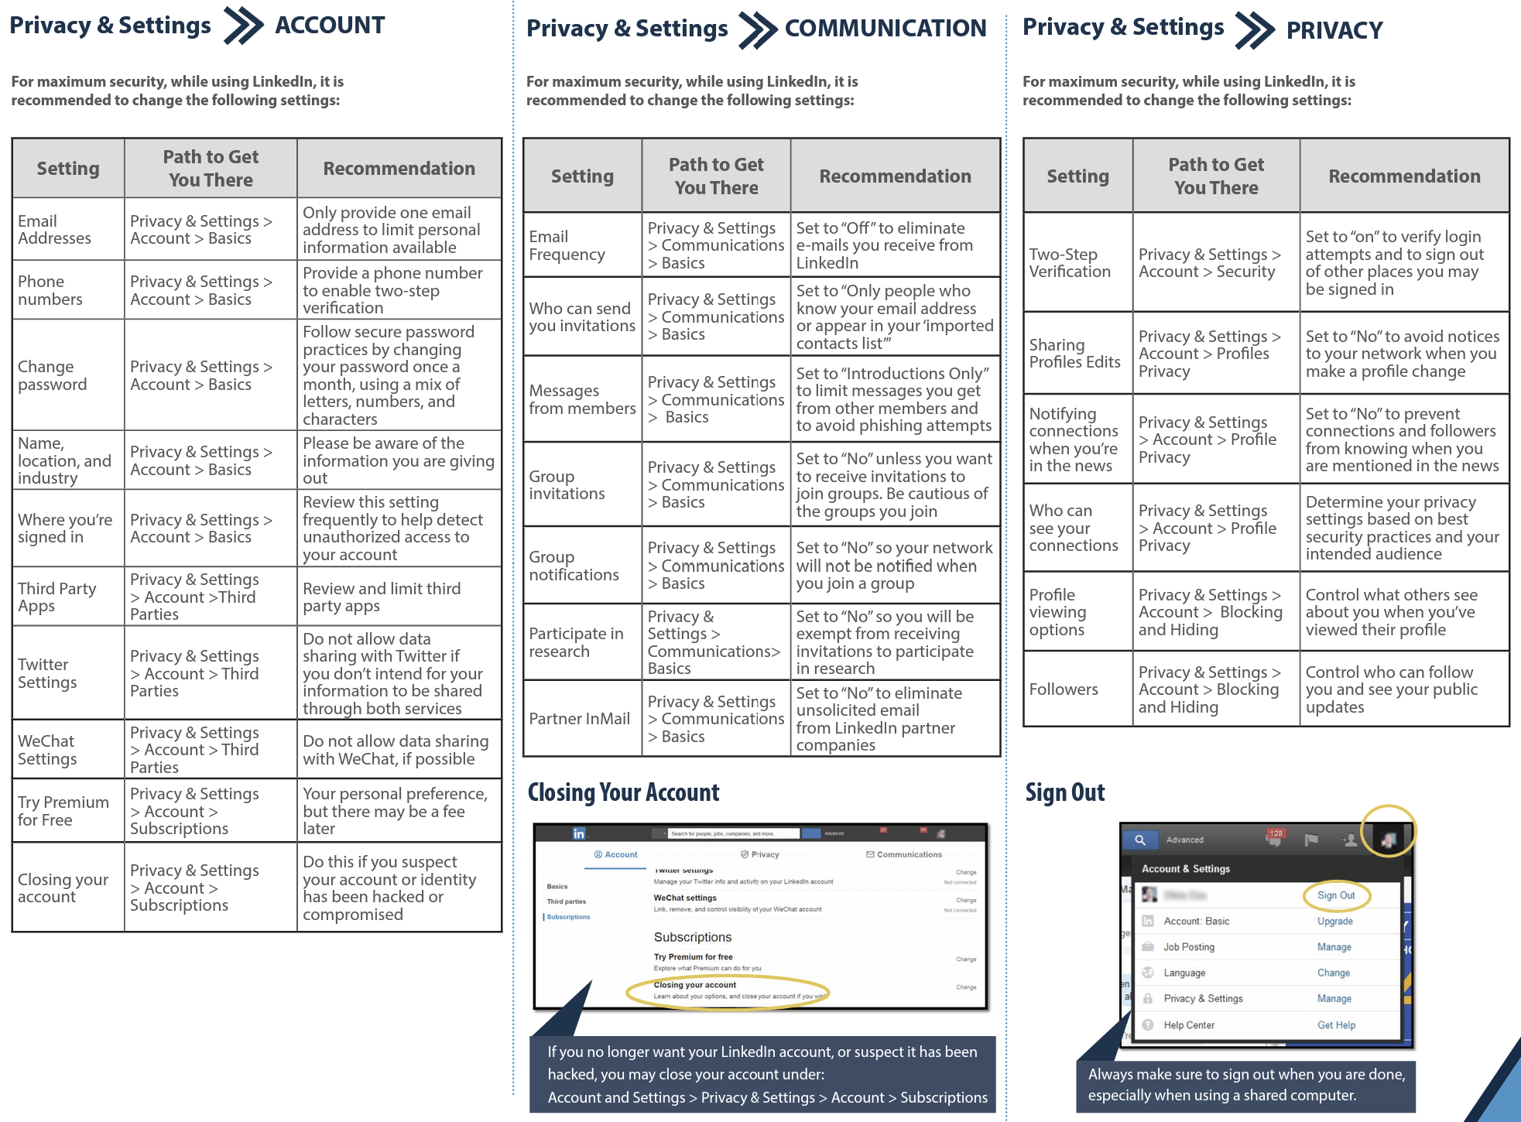
Suggested LinkedIn Privacy & Safety Settings
Source: Source: https://www.cdse.edu/Portals/124/Documents/jobaids/cyber/cyb-facebook-smartcard.pdf?ver=9evqdckfQgOngmwL7OHMOA%3d%3d

Slide 28

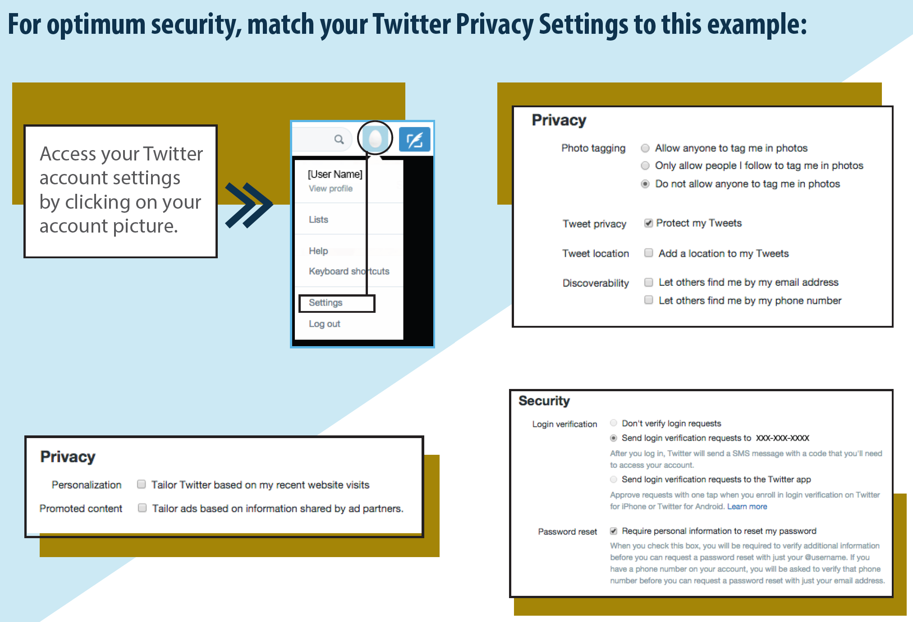
CDSE Recommendations
• Block “Direct Messages” from people you do not know.
• If you want to restrict your audience to specific user accounts, deny follow requests from people you do not know.
• De-select all Twitter tracking options.
• Establish and maintain connections with only people you know and trust; review your connections on a regular basis.
• Encourage your family and friends to take similar precautions with their accounts; their privacy and sharing settings can expose your personal data.
• Require login verification and personal information to reset your password.
• Set your account to “Private” to control who may follow (see), retweet (share), or quote (share with comment) your tweets.
https://help.twitter.com/en/safety-and-security
Source: https://www.cdse.edu/Portals/124/Documents/jobaids/cyber/cyb-twitter-smartcard.pdf?ver=r6-OLp-b8A5YA_rQ9sI2AQ%3d%3d

Slide 29

Learning Checkpoint

Slide 30
Placeholder for game slides

Slide 31



Magic 8 Ball
Cyber Security
Awareness Game
START

Slide 32



Backing up important files offline, on an external hard drive or in the cloud, will help protect your business in the event of a cyber attack.
ASK

Slide 33
Back up important files offline, on an external hard drive or in the cloud, to help protect your files.
YES
NEXT

Slide 34
Cyber criminals only target large companies.
ASK

Slide 35
Larger companies are the biggest targets because they have more money. However, small companies are perceived to be easier to hack or scam. They assume security controls are not as strict.
NO
NEXT

Slide 36
An email from your boss asks for the name, addresses, and credit card information of the company’s top clients. The email says it’s urgent and to please reply right away. Should you reply right away?
ASK

Slide 37
It may be a phishing attempt. Check it out first and confirm whether the request was really from your boss.
NO
NEXT

Slide 38
You get a text message from a vendor who asks you to click on a link to renew your password so that you can log in to its website. You should reply to the text to confirm that you really need to change your password.
ASK

Slide 39
To confirm that the request is real, you should call your vendor using a number you know to be correct. Do not reply to the text itself or use a number in the text, or else you might just wind up talking to a scammer.
NO
NEXT

Slide 40
If you fall for a phishing scam, you should delete the email immediately.
ASK

Slide 41
To limit the damage, you should immediately change any compromised passwords and disconnect from the network any computer or device that could be infected with malware because of the phishing attack. Deleting the email will not stop any damage the attack may have caused.
NO
NEXT

Slide 42
Ransomware is software that infects computer networks and mobile devices to hold your data hostage until you send the attackers money.
ASK

Slide 43
This is correct!
YES
NEXT

Slide 44
Setting your software to auto-update is one way you can help protect your business from ransomware.
ASK

Slide 45
This is correct! To keep your security up to date, it’s important to install the latest patches and updates. Setting them to update automatically can help you make it happen. On mobile devices, you may have to do it manually.
YES
NEXT

Slide 46
If you encounter a ransomware attack, the first thing you should do is pay the ransom.
ASK

Slide 47
The first thing you should do is disconnect the infected computer or device from your network. If your data has been stolen, take steps to protect your company and notify those who might be affected. Report the attack right away to your local FBI office. Check to see if you can restore your systems from back-ups. Then determine whether to pay the ransom, knowing that law enforcement doesn’t recommend it and that paying the ransom doesn’t guarantee you’ll get your data back.
NO
NEXT

Slide 48
When you hit the [delete] key to get rid of a file, that means the file is removed from your computer.
ASK

Slide 49
“Delete” alone does not actually remove a file from a computer. Use software to erase data, especially before you donate or discard old computers, mobile devices, digital copiers, and drives.
NO
NEXT

Slide 50
Requiring vendors to use multi-factor authentication to access your network makes users take an additional step beyond logging in with a password.
ASK

Slide 51
Multi-factor authentication makes vendors take an additional step beyond logging in with a password to access your network. A temporary code on a smartphone or a hardware device gives an extra layer of protection for business data and personal information on your network.
YES
NEXT

Slide 52
Phishing is a scamming technique where someone sends a text message that contains a malicious link disguised to look like a notification that the person has won a contest.
ASK

Slide 53
Phishing is a technique where a scammer sends an email that contains a malicious link disguised to look like an email from a person the victim knows.
NO
NEXT

Slide 54
If a public wi-fi network (such as in an airport or café) requires a password to access it, this means it is generally safe to use that network for sensitive activities such as online banking.
ASK

Slide 55
Even if a public wi-fi network requires a password, other users can potentially view the sensitive information a user sends across that wi-fi network.
NO
NEXT

Slide 56
Thank you for playing Cybersecurity
Magic 8 Ball!

Slide 57
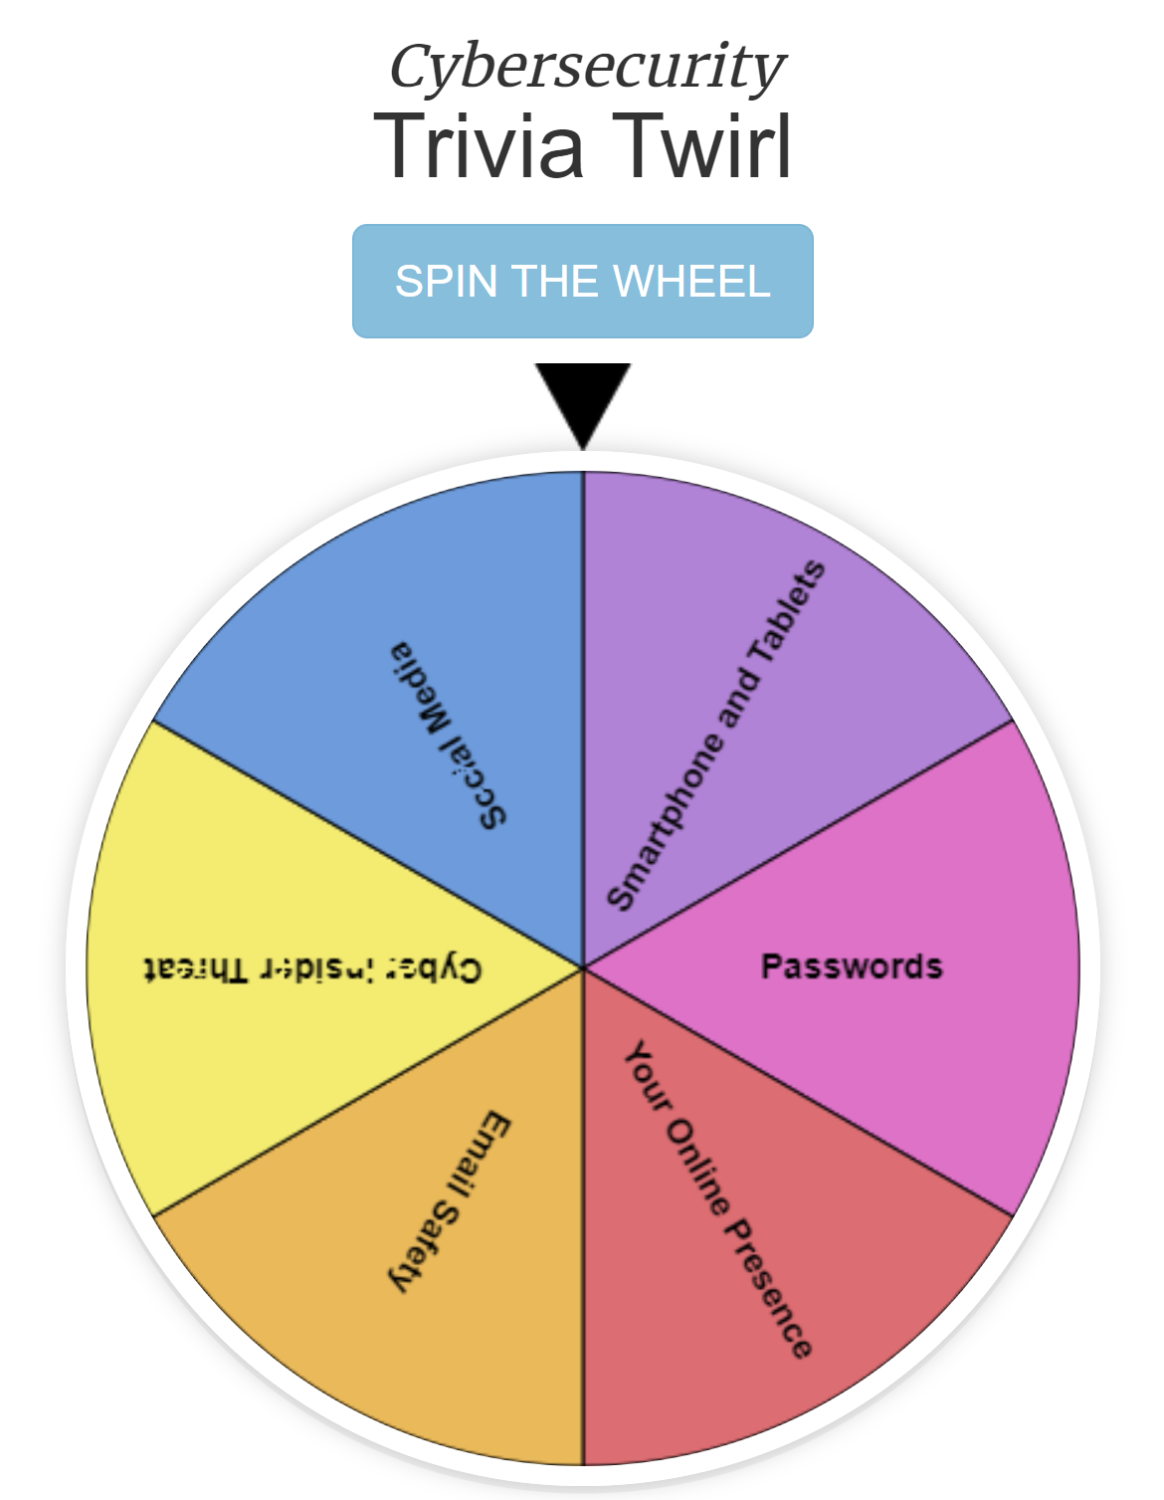
Learning Checkpoint
Cybersecurity Trivia
Open a browser and go to: https://securityawareness.usalearning.gov/cdse/multimedia/games/cybertrivia/index.html#

Slide 58
Learning Checkpoint
Cybersecurity Online Crossword Puzzle
Open a browser and go to: https://securityawareness.usalearning.gov/cdse/multimedia/games/cybersecurity-crossword/index.html

Slide 59
BREAK

Slide 60
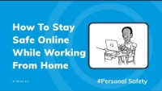
Tips for staying safe while working remotely
Source: https://www.youtube.com/watch?v=DRTWeqPpM2s

Slide 61
Tips for working from home
Create your own office space and keep others in the family from using it.
Don’t leave confidential paperwork laying around.
Lock your computer when not in your working area. [WINDOWS + L] key
Don’t use your personal email to send yourself work documents.
Use only company-approved applications and devices when communicating with your co-workers and business contacts (e.g. Teams, work email account, company laptop or phone).
If you get a request for confidential information from a co-worker, call or contact your co-worker to verify they made the request.
Have Siri turned off and put Alexa and Google Home devices in another room to make sure they aren’t listening.
Adapted from: https://www.wizer-training.com/guides/work-from-home

Slide 62
Tips for working from home
(continued)
Do not share company devices with family members.
Don’t save your passwords to your browser!
Use long pass phrases for your passwords and make each account with a different pass phrase.
Don’t use your work computer for personal activities.
Whenever possible use a hard-wired network connection instead of a wireless one.
Always apply the security patches sent to your company-issued devices (e.g. computer, tablet, and/or phone).
Make sure you are backing up your data using the approved method provided by the company.
Adapted from: https://www.wizer-training.com/guides/work-from-home

Slide 63
Final Remarks
Training Effectiveness Survey
https://bit.ly/3vVH1vt

